Slide 1

Port Authority Bus Terminal Passenger Prediction
Team Members - Group 4 :
Vekata Jyoshna Narapareddy
Pooja Dilip Talikoti
Mansi Jain
Srija Sripalli
Mythri Potluri
Nehitha Reddy Aramati

Slide 2
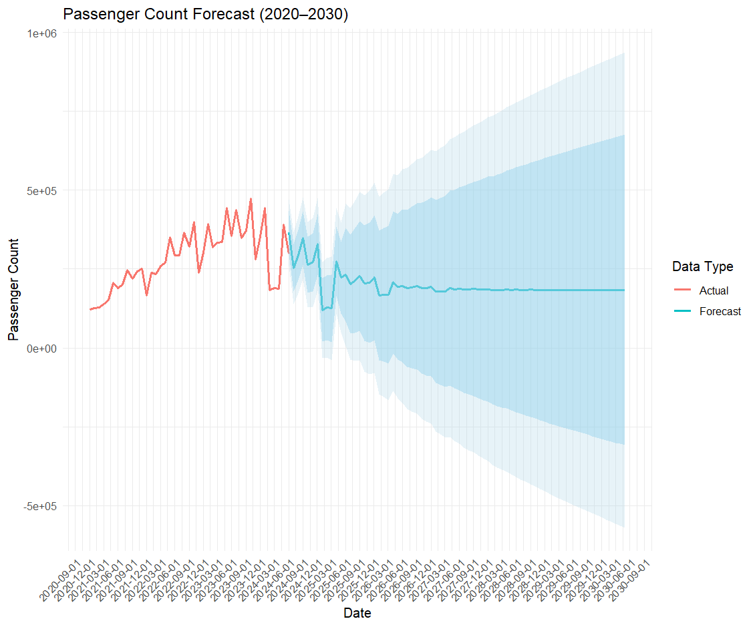
Forecasting the passengers from 2025-2030
We are having the data from 2020 to 2024 by using this data we have forecasted the total number of passengers from 2025-2030.
This forecasted data helps the Port Authority plan resources and capacity for future demand and mainly for building the temporary staging facilities.
Mitigates risks by preparing contingency plans for worst-case scenarios.

Slide 3
Critical Factors Influencing the number of Passengers
Linear Regression Model :
Using historical data, we developed a regression model to analyze how various weather factors influence passenger numbers at the bus terminal. This model helps identify critical variables that affect passenger usage, supporting operational and planning decisions for the Port Authority.
The model highlights snow depth as a significant factor negatively impacting passenger numbers, indicating the need for mitigation strategies during severe winter conditions.

Slide 4
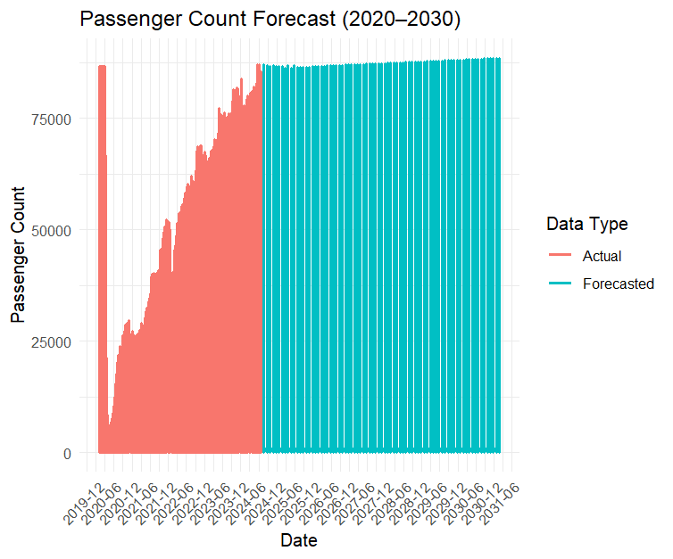
Forecasted Passenger count by Individual Carrier
We have forecasted the data for each carrier from 2025-2030 using ARIMA Model Time Series Forecasting.
We have then stored this data into excel file and have created visuals in Power BI so that we can check the forecasted data for specific carrier and get the insights needed from that data as which carrier is being used mostly.

Slide 5
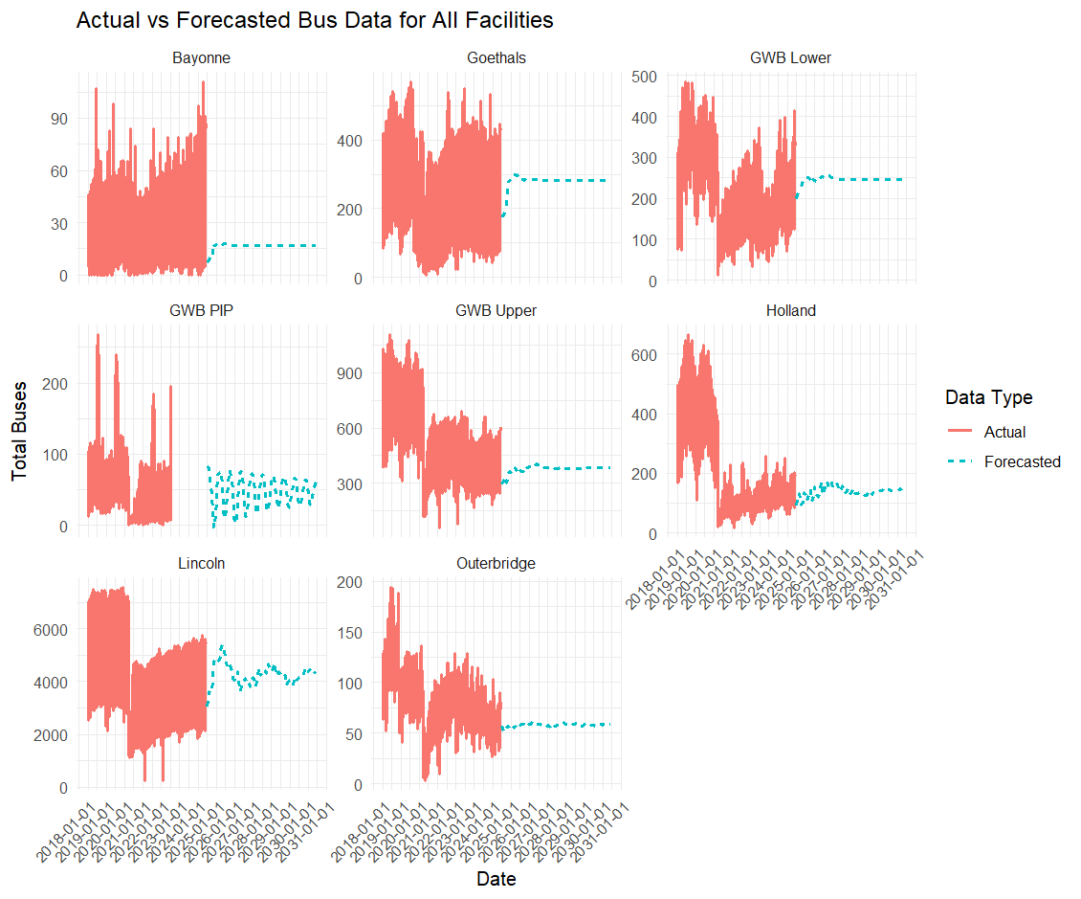
Forecasted Peak Usage Times for Staging Facilities (2025-2030)
We have forecasted the data for all the staging facilities from 2025-2030 and then created the weekly, monthly and yearly visuals for all the facilities.

Slide 6
Comparison of Current Usage (2023) vs. Pre-COVID Levels (2019)
We have compared the passenger data from 2019 (pre-COVID) with 2023 to assess how the pandemic impacted bus terminal usage. This comparison was done to understand the long-term effects on passenger volume and highlight any recovery trends.
The data reveals that the number of passengers in 2023 is lower than in 2019, indicating a significant decline. Despite some recovery, the overall passenger volume has not yet returned to pre-COVID levels, which suggests lingering impacts on travel patterns.
The ongoing lower passenger count in 2023 suggests that shifts in commuter behavior, such as remote work and changed travel priorities, may be contributing to a slower recovery. Adjusting services to accommodate these changes could accelerate the return to pre-COVID levels.

Slide 7
Recommendations:
Address Weather Impacts:
Prepare contingency plans for heavy snow periods to minimize ridership disruptions.
1
Collaborate with Key Carriers:
Strengthen partnerships with major carriers and support smaller ones to ensure service stability.
2
Plan Facility Expansions:
Upgrade capacity at high-traffic hubs like Holland to meet rising demand through 2030.
3
Track Passenger Trends:
Compare forecasted vs. actual passenger numbers to optimize operations.
4
Expand Data Insights:
Collect data on delays, customer feedback, and maintenance to refine forecasts.
5

Slide 8
Thankyou

